Slide 1
Data Mining
Lecture 9

Slide 2
Course Syllabus
Classification Techniques (Week 7- Week 8- Week 9)
  Inductive Learning
  Decision Tree Learning
  Association Rules
  Regression
  Probabilistic Reasoning
  Bayesian Learning
Case Study 4: Working and experiencing on the properties of the classification infrastructure of Propensity Score Card System for The Retail Banking (Assignment 4) Week 9

Slide 3
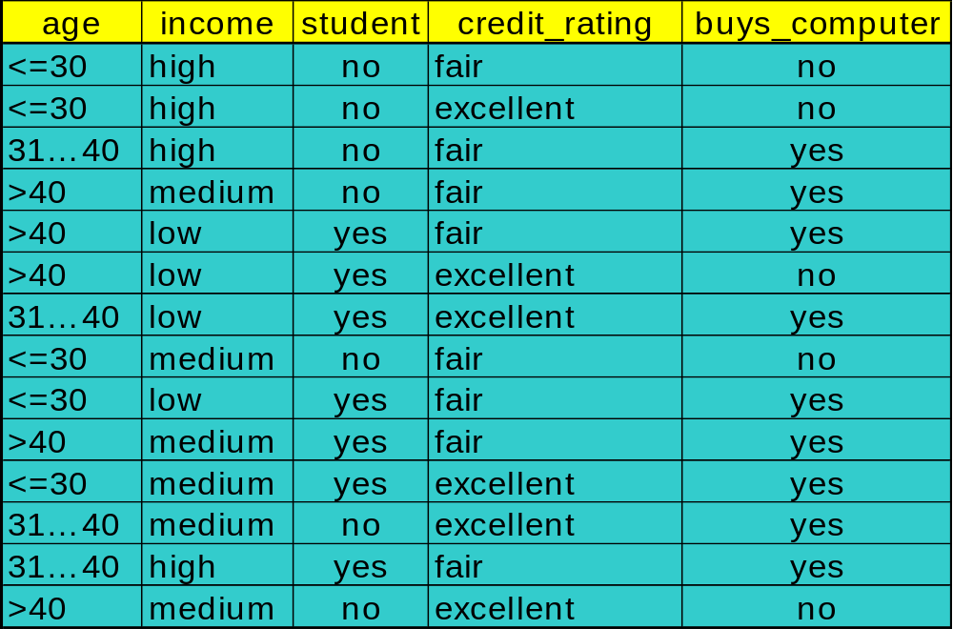
Decision Tree Induction: Training Dataset
This follows an example of Quinlan’s ID3 (Playing Tennis)

Slide 4
Output: A Decision Tree for “buys_computer”
age?
<=30
overcast
>40
31..40
student?
yes
credit rating?
no
yes
excellent
fair
no
yes
no
yes

Slide 5
Algorithm for Decision Tree Induction
Basic algorithm (a greedy algorithm)
  Tree is constructed in a top-down recursive divide-and-conquer manner
  At start, all the training examples are at the root
  Attributes are categorical (if continuous-valued, they are discretized in advance)
  Examples are partitioned recursively based on selected attributes
  Test attributes are selected on the basis of a heuristic or statistical measure (e.g., information gain)
Conditions for stopping partitioning
  All samples for a given node belong to the same class
  There are no remaining attributes for further partitioning – majority voting is employed for classifying the leaf
  There are no samples left

Slide 6
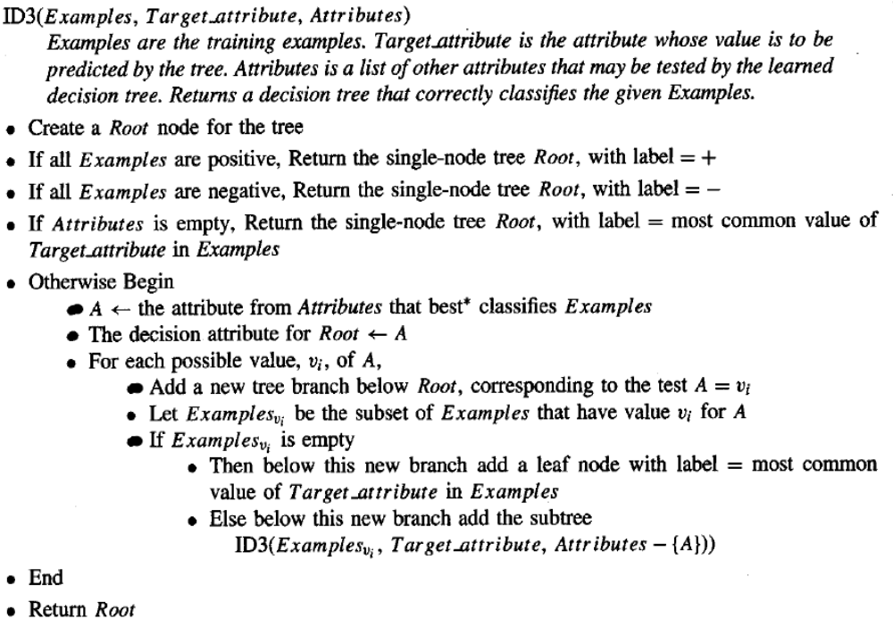
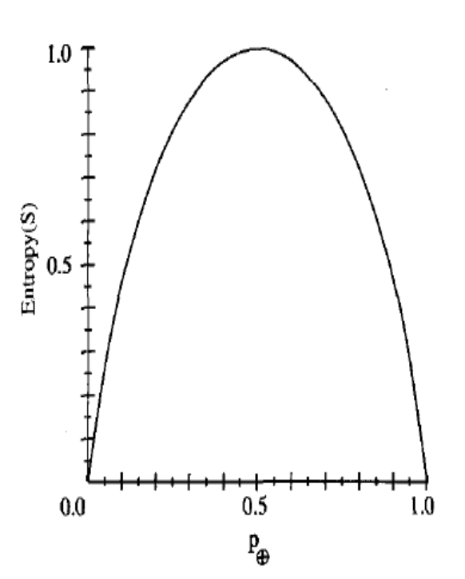
ID3 and Entropy

Slide 7

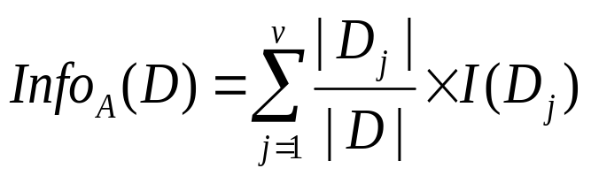

Attribute Selection Measure: Information Gain (ID3/C4.5)
Select the attribute with the highest information gain
Let p_{i} be the probability that an arbitrary tuple in D belongs to class C_{i}, estimated by |C_{i, D}|/|D|
Expected information (entropy) needed to classify a tuple in D:
Information needed (after using A to split D into v partitions) to classify D:
Information gained by branching on attribute A
Data Mining: Concepts and Techniques
Notes:
I : the expected information needed to classify a given sample
E (entropy) : expected information based on the partitioning into subsets by A

Slide 8





Attribute Selection: Information Gain
Class P: buys_computer = “yes”
Class N: buys_computer = “no”
means “age <=30” has 5 out of 14 samples, with 2 yes’es and 3 no’s. Hence
Similarly,

Slide 9
ID3- Hypothesis Space Analysis
a complete space of finite discrete-valued functions, relative to the available attributes
maintains only a single current hypothesis as it searches through the space of decision trees. This contrasts, for example, with the earlier version space Candidate Elimination, which maintains the set of all hypotheses consistent with the available training examples
no backtracking in its search; converging to locally optimal solutions that are not globally optimal
at each step in the search to make statistically based decisions regarding how to refine its current hypothesis. This contrasts with Inductive Learning’s incremental approach
Approximate inductive bias of ID3: Shorter trees are preferred over larger trees

Slide 10
ID3- Hypothesis Space Analysis
A closer approximation to the inductive bias of ID3: Shorter trees are preferred over longer trees. Trees that place high information gain attributes close to the root are preferred over those that do not.

Slide 11
Why short hypothesis preferred ?- Occam’s Razor
William of Occam's Razor (1320): Prefer the simplest hypothesis that fits the data
because there are fewer short hypotheses than long ones (based on straightforward combinatorial arguments), it is less likely that one will find a short hypothesis that coincidentally fits the training data. In contrast there are often many very complex hypotheses that fit the current training data but fail to generalize correctly to subsequent data
still this debate goes on
Data Mining: Concepts and Techniques

Slide 12
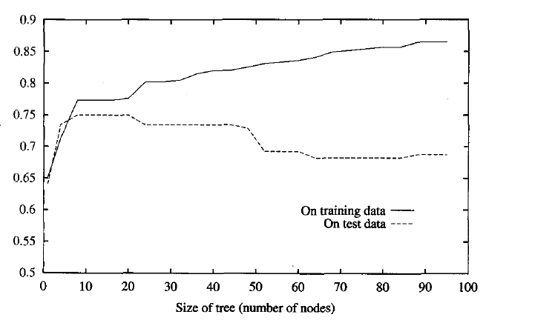
Issues in Decision Tree Learning- Overfitting
a hypothesis overfits the training examples if some other hypothesis that fits the training examples less well actually performs better over the entire distribution of instances
Data Mining: Concepts and Techniques

Slide 13
Issues in Decision Tree Learning- Overfitting
Reasons of Overfitting
when the training examples contain random errors or noise and learning algorithm tries to explain this randomness
overfitting is possible even when the training data are noise-free, especially when small numbers of examples are associated with leaf nodes; coincidental regularities to occur, in which some attribute happens to partition the examples very well, despite being unrelated to the actual target function
Data Mining: Concepts and Techniques

Slide 14
Avoiding Overfitting
approaches that stop growing the tree earlier, before it reaches the point where it perfectly classifies the training data (it is difficult estimating precisely when to stop growing the tree
approaches that allow the tree to overfit the data, and then post-prune the tree (cut the tree to make it smaller; much more practical)
Data Mining: Concepts and Techniques

Slide 15
Avoiding Overfitting
Use a separate set of examples, distinct from the training examples, to evaluate the utility of post-pruning nodes from the tree.
Use all the available data for training, but apply a statistical test to estimate whether expanding (or pruning) a particular node is likely to produce an improvement beyond the training set. For example, Quinlan (1986) uses a chi-square test to estimate whether further expanding a node is likely to improve performance over the entire instance distribution, or only on the current sample of training data.
Use an explicit measure of the complexity for encoding the training examples and the decision tree, halting growth of the tree when this encoding size is minimized. This approach, based on a heuristic called the Minimum Description Length principle
Data Mining: Concepts and Techniques

Slide 16
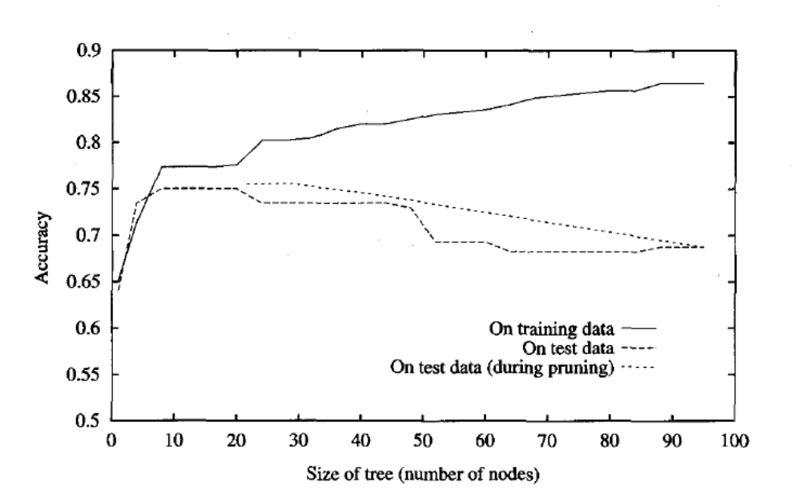
Avoiding Overfitting
Data Mining: Concepts and Techniques

Slide 17

Avoiding Overfitting
The major drawback of this approach is that when data is limited, withholding part of it for the validation set reduces even further the number of examples available for training
Continuous Valued Attributes
ID3 algorithm work on discrete valued attributes; thats why some arrangements must be done to add the ability of working with continuous valued attributes
Simple strategy sort our continues valued attribute and determine classifier’s changing point (for exampl(48-60), (80-90) points for the below given case
Take the mid point of changing points as candidates of discretization ((48+60)/2), ((80+90)/2)
Data Mining: Concepts and Techniques

Slide 18
Computing Information-Gain for Continuous-Value Attributes
Let attribute A be a continuous-valued attribute
Must determine the best split point for A
  Sort the value A in increasing order
  Typically, the midpoint between each pair of adjacent values is considered as a possible split point
    (a_{i}+a_{i+1})/2 is the midpoint between the values of a_{i} and a_{i+1}
  The point with the minimum expected information requirement for A is selected as the split-point for A
Split:
  D1 is the set of tuples in D satisfying A ≤ split-point, and D2 is the set of tuples in D satisfying A > split-point
Data Mining: Concepts and Techniques

Slide 19
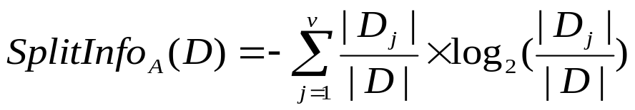
Gain Ratio for Attribute Selection (C4.5)
Information gain measure is biased towards attributes with a large number of values
C4.5 (a successor of ID3) uses gain ratio to overcome the problem (normalization to information gain)
  GainRatio(A) = Gain(A)/SplitInfo(A)
Ex.
  gain_ratio(income) = 0.029/0.926 = 0.031
The attribute with the maximum gain ratio is selected as the splitting attribute
Data Mining: Concepts and Techniques

Slide 20
Issues in Decision Tree Learning
Handle missing attribute values
  Assign the most common value of the attribute
  Assign probability to each of the possible values
Attribute construction
  Create new attributes based on existing ones that are sparsely represented
  This reduces fragmentation, repetition, and replication

Slide 21
Other Attribute Selection Measures
CHAID: a popular decision tree algorithm, measure based on χ² test for independence
C-SEP: performs better than info. gain and gini index in certain cases
G-statistics: has a close approximation to χ² distribution
MDL (Minimal Description Length) principle (i.e., the simplest solution is preferred):
  The best tree as the one that requires the fewest # of bits to both (1) encode the tree, and (2) encode the exceptions to the tree
Multivariate splits (partition based on multiple variable combinations)
  CART: finds multivariate splits based on a linear comb. of attrs.
Which attribute selection measure is the best?
  Most give good results, none is significantly superior than others
Data Mining: Concepts and Techniques

Slide 22



Gini index (CART, IBM IntelligentMiner)
If a data set D contains examples from n classes, gini index, gini(D) is defined as
where p_{j} is the relative frequency of class j in D
If a data set D is split on A into two subsets D₁ and D₂, the gini index gini(D) is defined as
Reduction in Impurity:
The attribute provides the smallest gini_{split}(D) (or the largest reduction in impurity) is chosen to split the node (need to enumerate all the possible splitting points for each attribute)

Slide 23
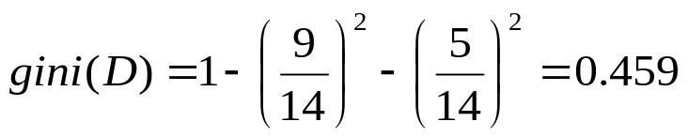

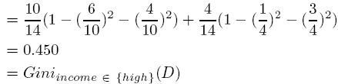
Gini index (CART, IBM IntelligentMiner)
Ex. D has 9 tuples in buys_computer = “yes” and 5 in “no”
Suppose the attribute income partitions D into 10 in D₁: {low, medium} and 4 in D₂
  but gini_{{medium,high}} is 0.30 and thus the best since it is the lowest
All attributes are assumed continuous-valued
May need other tools, e.g., clustering, to get the possible split values
Can be modified for categorical attributes
Data Mining: Concepts and Techniques

Slide 24
Comparing Attribute Selection Measures
The three measures, in general, return good results but
  Information gain:
    biased towards multivalued attributes
  Gain ratio:
    tends to prefer unbalanced splits in which one partition is much smaller than the others
  Gini index:
    biased to multivalued attributes
    has difficulty when # of classes is large
    tends to favor tests that result in equal-sized partitions and purity in both partitions
Data Mining: Concepts and Techniques

Slide 25

Bayesian Learning
Bayes theorem is the cornerstone of Bayesian learning methods because it provides a way to calculate the posterior probability P(hlD), from the prior probability P(h), together with P(D) and P(D/h)

Slide 26
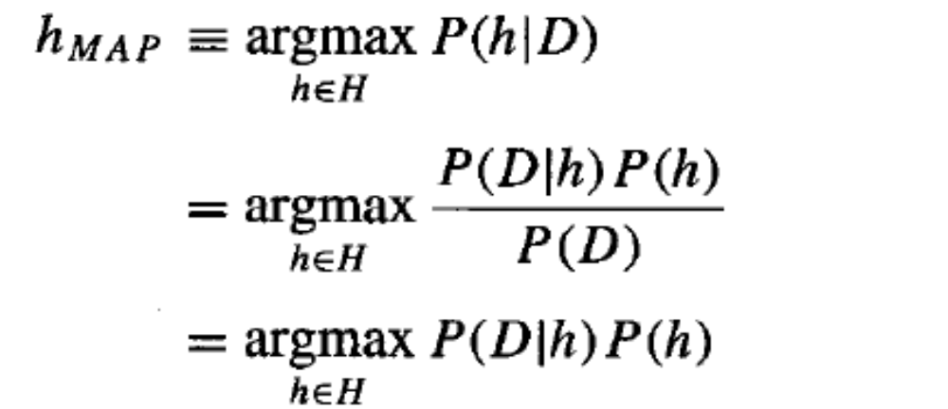
Bayesian Learning
finding the most probable hypothesis h E H given the observed data D (or at least one of the maximally probable if there are several). Any such maximally probable hypothesis is called a maximum a posteriori (MAP) hypothesis. We can determine the MAP hypotheses by using Bayes theorem to calculate the posterior probability of each candidate hypothesis. More precisely, we will say that MAP is a MAP hypothesis provided (in the last line we dropped the term P(D) because it is a constant independent of h)

Slide 27
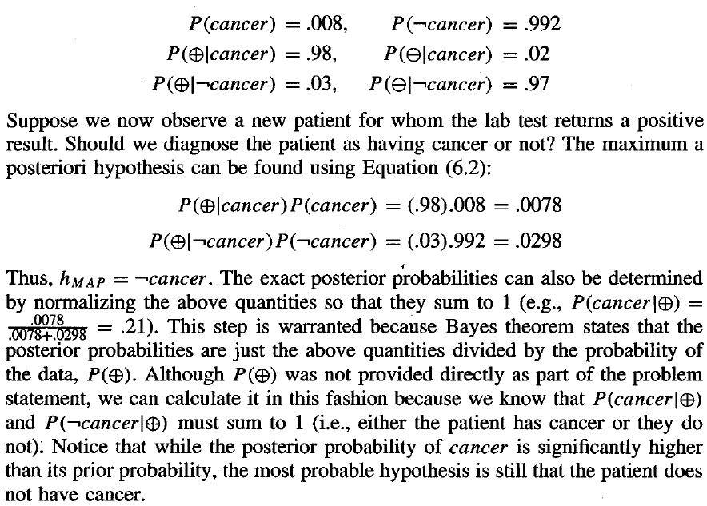
Bayesian Learning

Slide 28
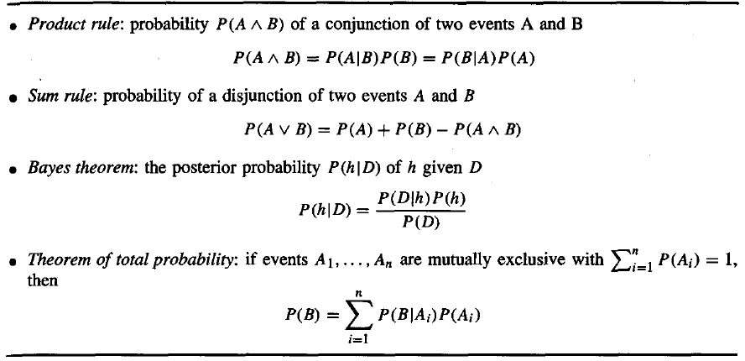
Probability Rules

Slide 29
End of Lecture
read Chapter 6 of Course Text Book
read Chapter 6 – Supplemantary Text Book “Machine Learning” – Tom Mitchell

